Slide 1

File System Recovery and Optimization tool
Presented by:
Gagandeep Singh
Suryansh
Ajay Sai Vardhan Reddy

Slide 2
Introduction
What is a File System?
A file system is a way of organizing, storing, retrieving, and managing data on storage devices.
Motivation
In this project, we simulate essential file system operations such as:
- Scanning directories
- Recovering files
- Optimizing file names

Slide 3
Objectives
🎯 Objectives of the Project:
✅ Simulate basic file system utilities
✅ Create a tool that helps visualize file recovery and optimization
✅ Learn system-level operations using Python and Flask
✅ Connect Operating System concepts with a real-world application

Slide 4
Technology Stack
⚙️ Backend:
- Python (Flask Framework)
- OS & Shutil modules
🖥️ Frontend:
- HTML, CSS, JavaScript
📁 Environment:
- Local Filesystem

Slide 5
Module 1 - Scan Filesystem
🔍 Function: scan_filesystem(directory)
📌 Description:
Lists all files in a given directory.
💡 OS Concept:
Simulates directory traversal (like 'ls' or 'dir').
✅ Example Output:
{
"files": ["doc1.txt", "image.png", "notes.pdf"]
}

Slide 6
Module 2 - Recover Files
♻️ Function: recover_files(directory, backup_directory)
📌 Description:
Restores files from a backup location into the main directory.
💡 OS Concept:
Simulates file recovery after deletion or crash.
📦 Uses:
shutil.copy2() – Preserves metadata during recovery

Slide 7
Module 3 - Optimize Filesystem
🧹 Function: optimize_filesystem(directory)
📌 Description:
Renames files using a consistent pattern (e.g., optimized_0_filename.txt)
💡 OS Concept:
Mimics file optimization and defragmentation.
🎯 Outcome:
Improved file order and naming clarity

Slide 8
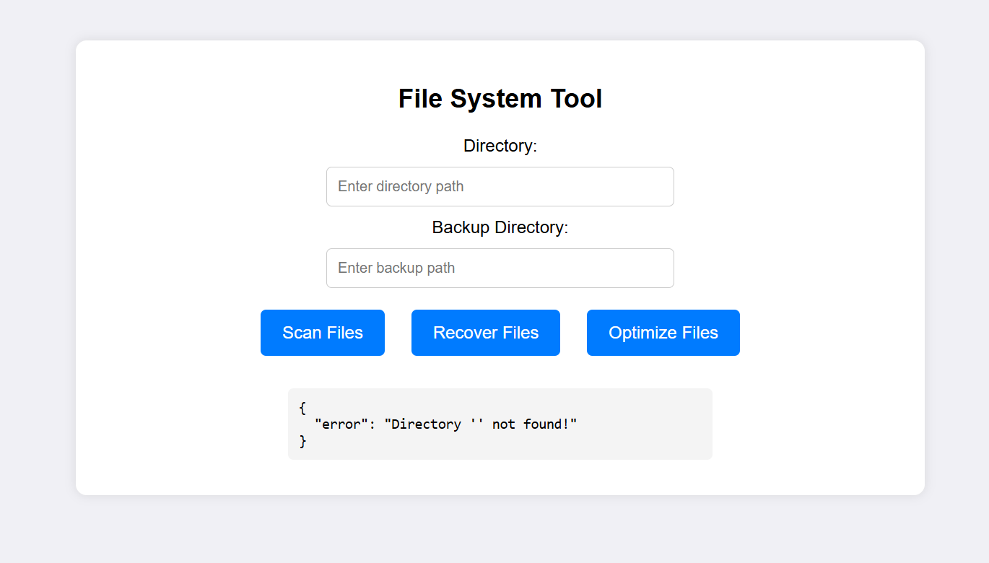
Sample UI

Slide 9
Challenges Faced
🚧 Challenges:
- Managing file permissions across OS
- Handling special characters in file names
- Maintaining performance with large file sets

Slide 10
Conclusion
📌 Summary:
- Gained practical experience in file handling
- Applied OS concepts like recovery, optimization, and directory traversal
- Built a tool that bridges theory and real-world usage

Slide 11
Thank You
Any Questions?

